Slide 1
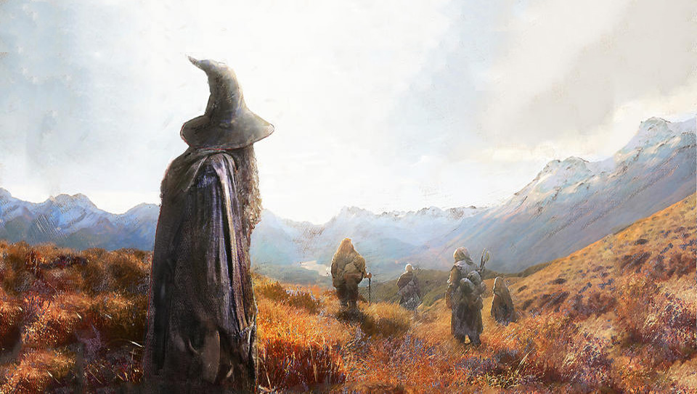

Slide 2

Demographic Data:
Movie Script:
Full Text of Books:
http://lotr.wikia.com/wiki/Main_Page
http://www.ageofthering.com/atthemovies/
https://archive.org/details/TheLordOfTheRing1TheFellowshipOfTheRing

Slide 5
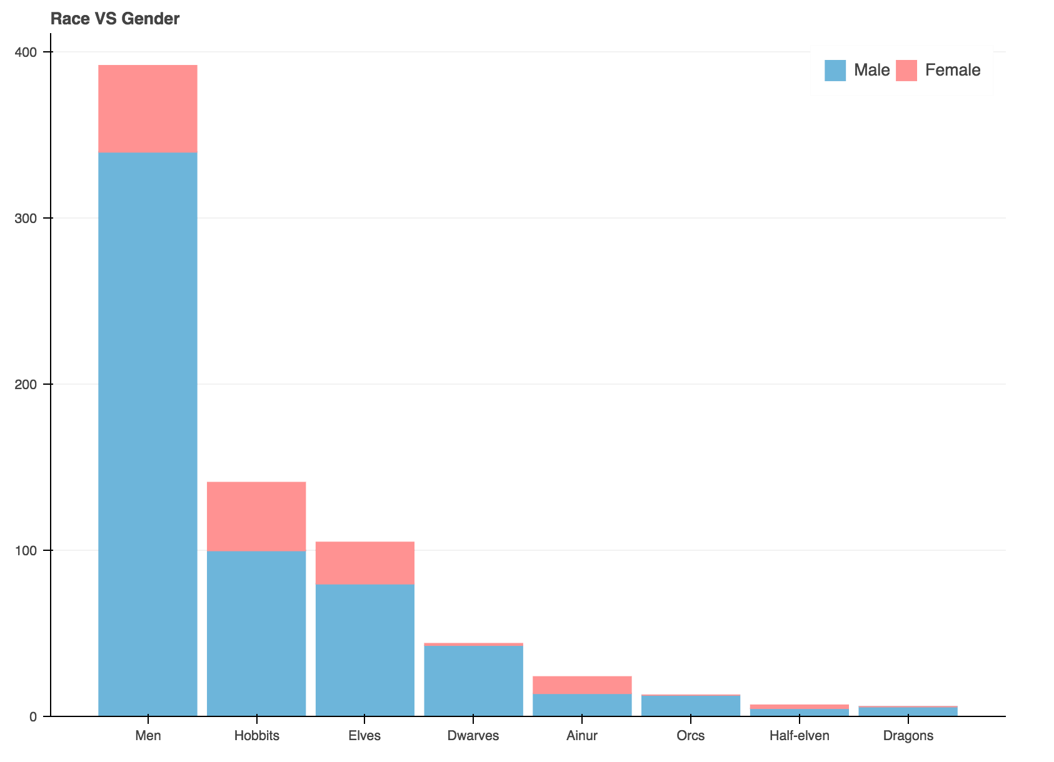

Slide 6
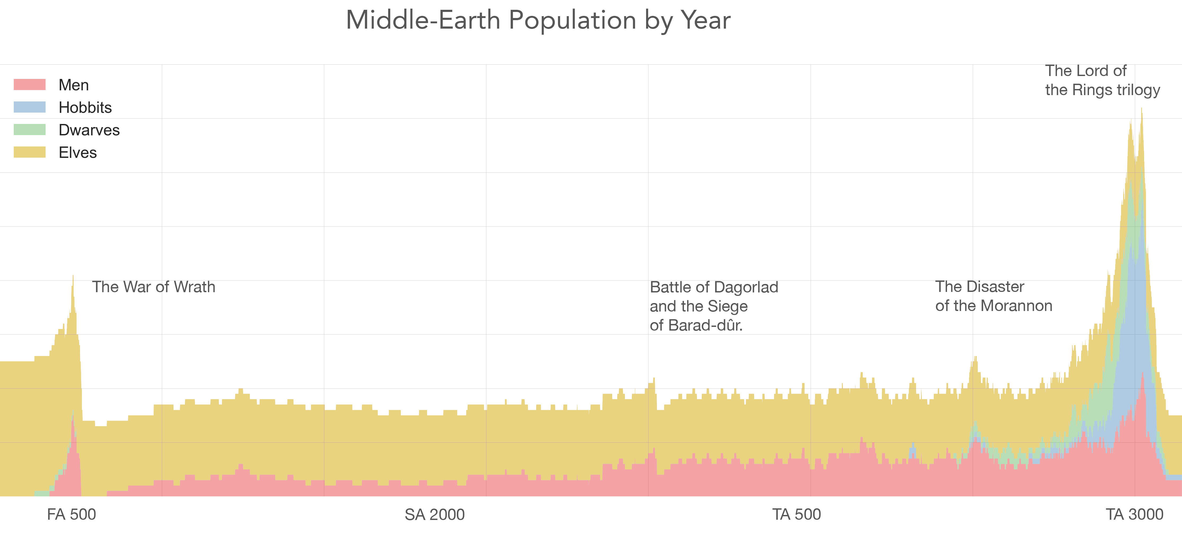

Slide 7
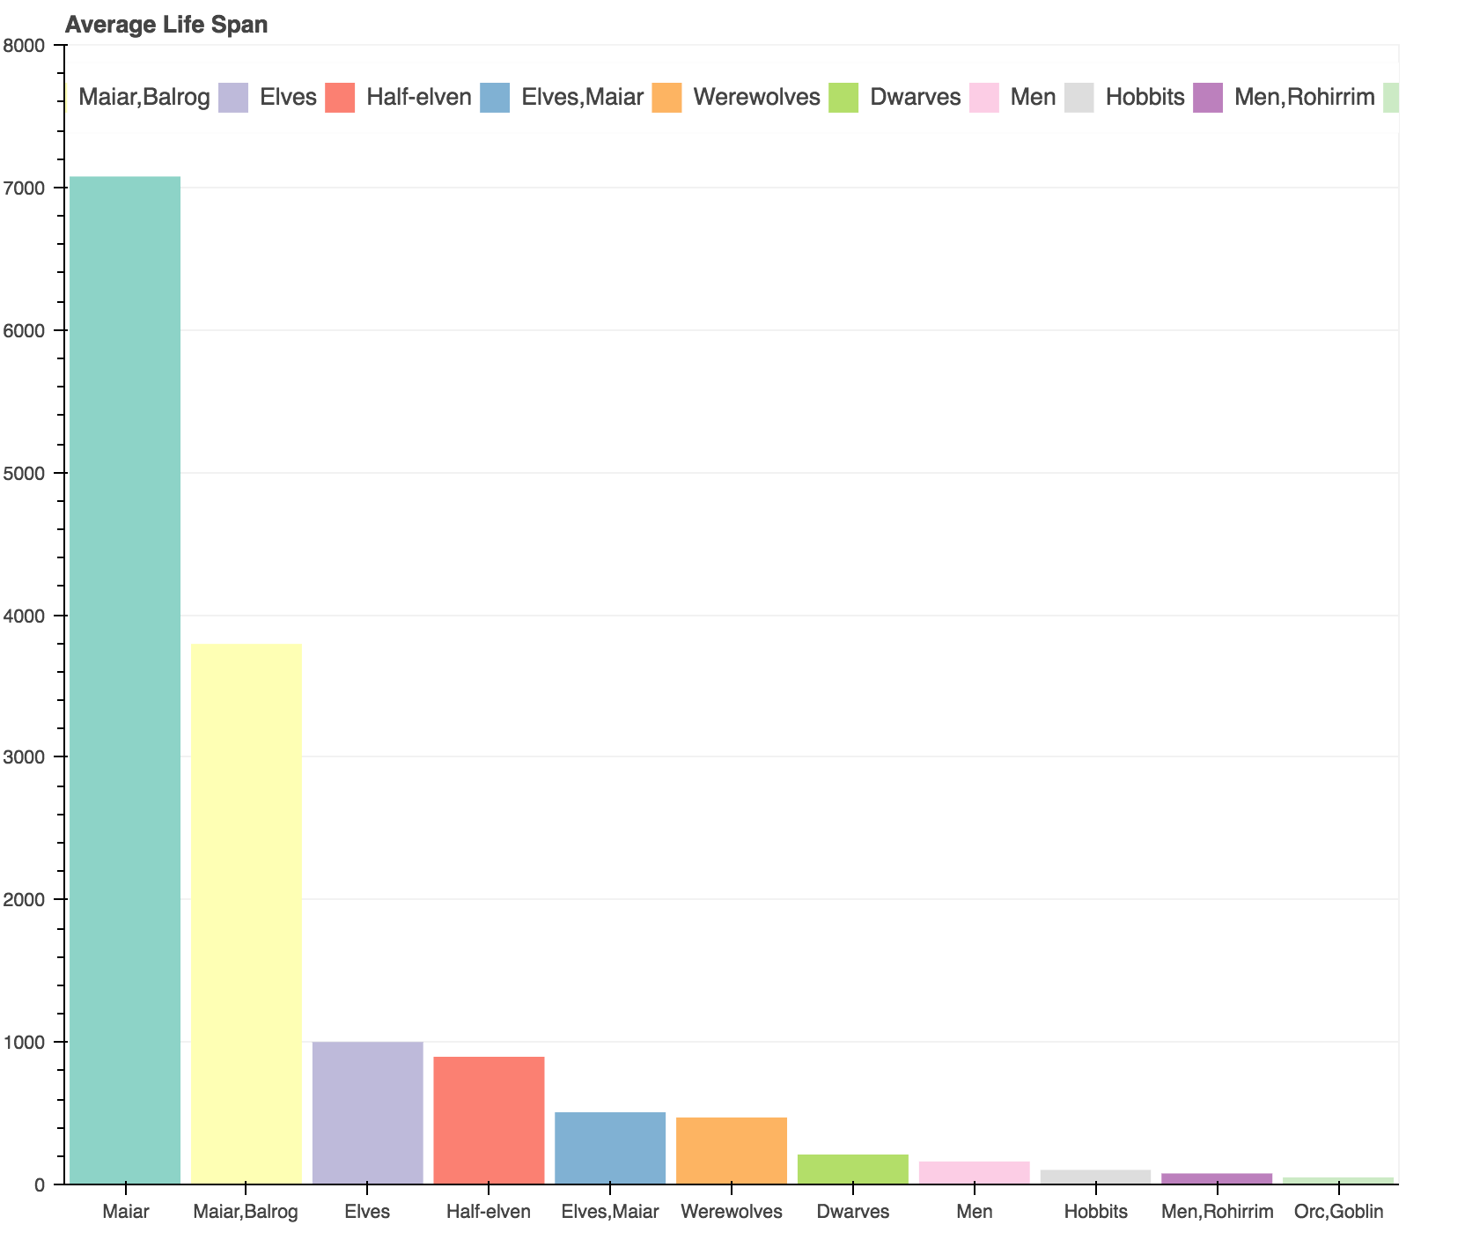

Slide 8
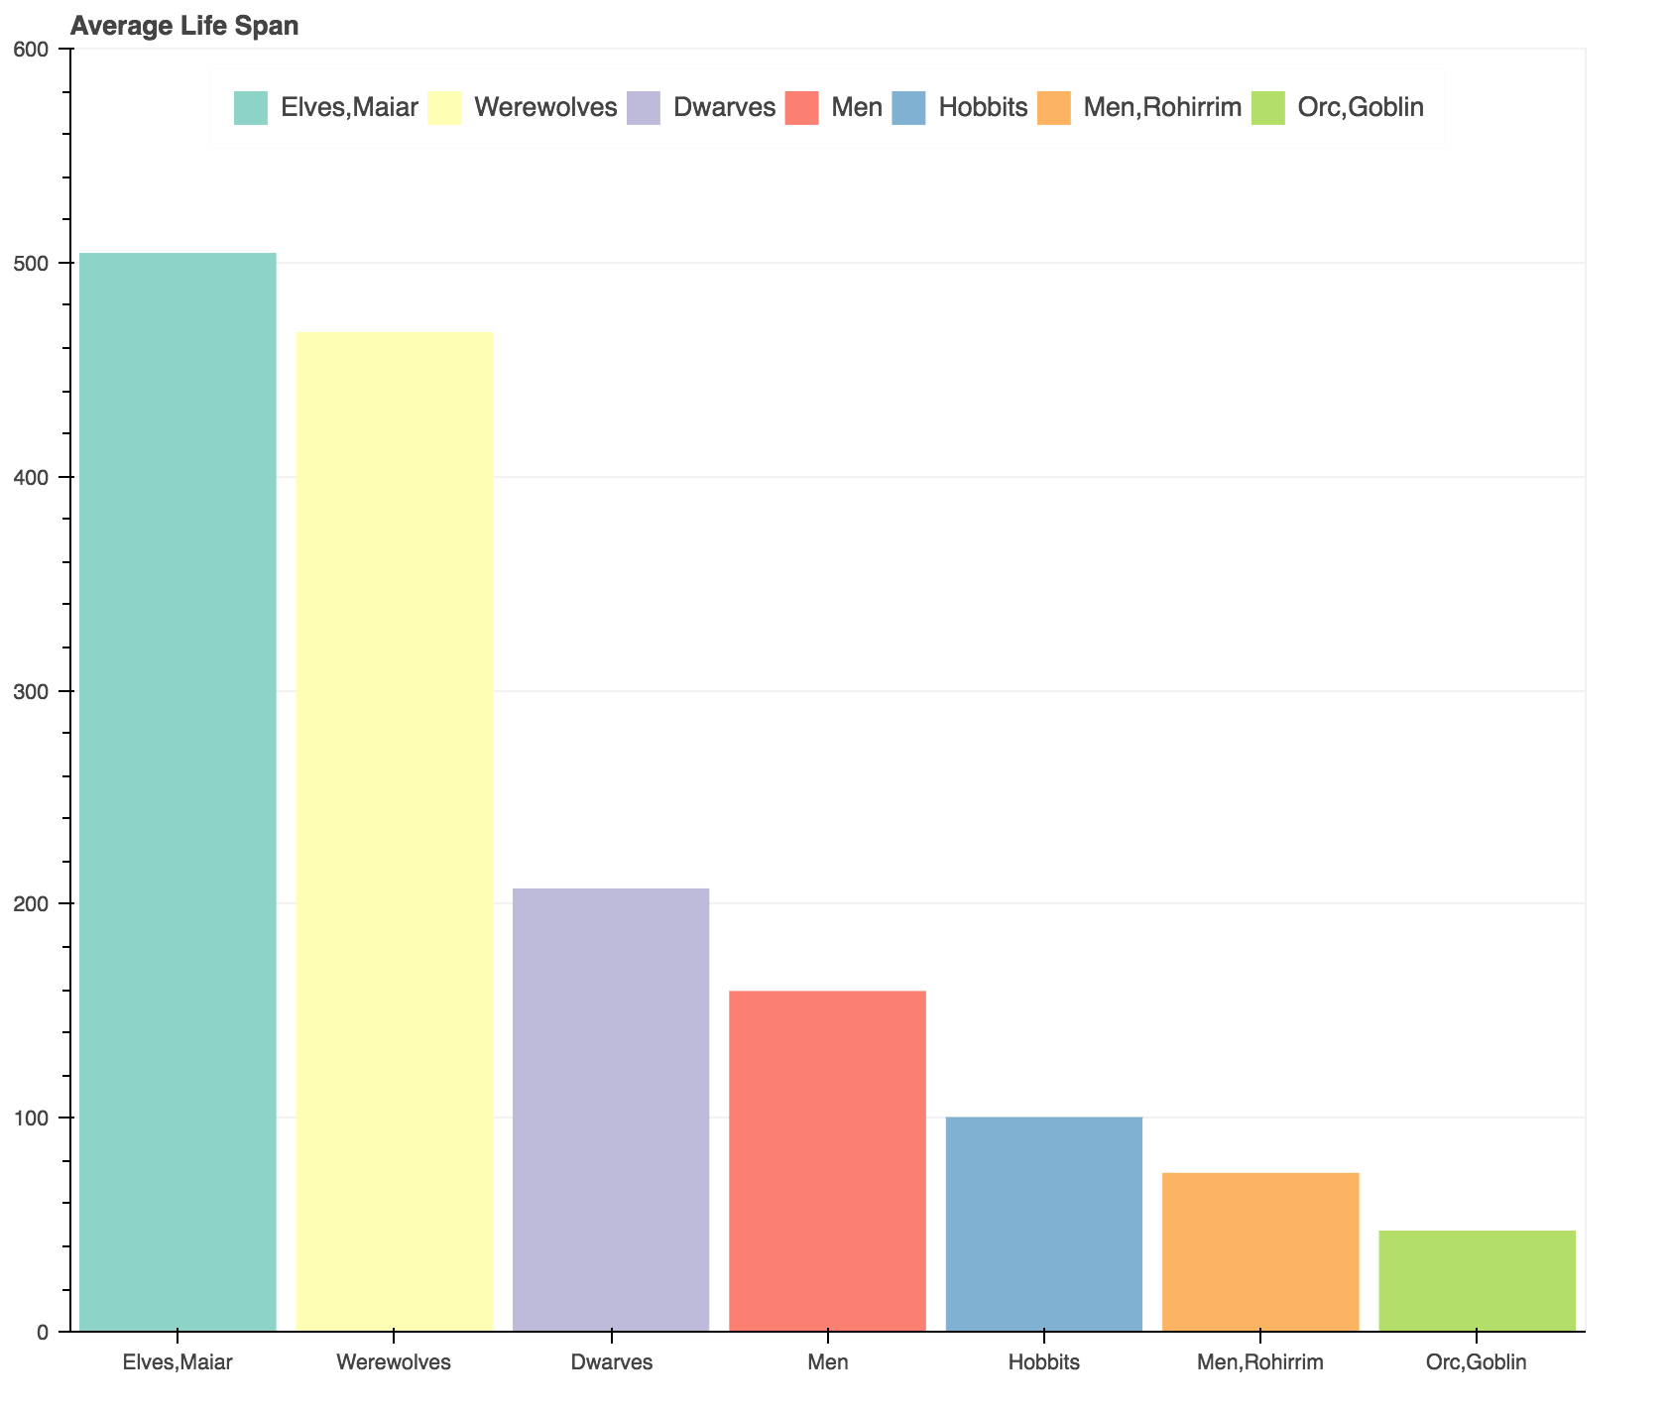

Slide 9
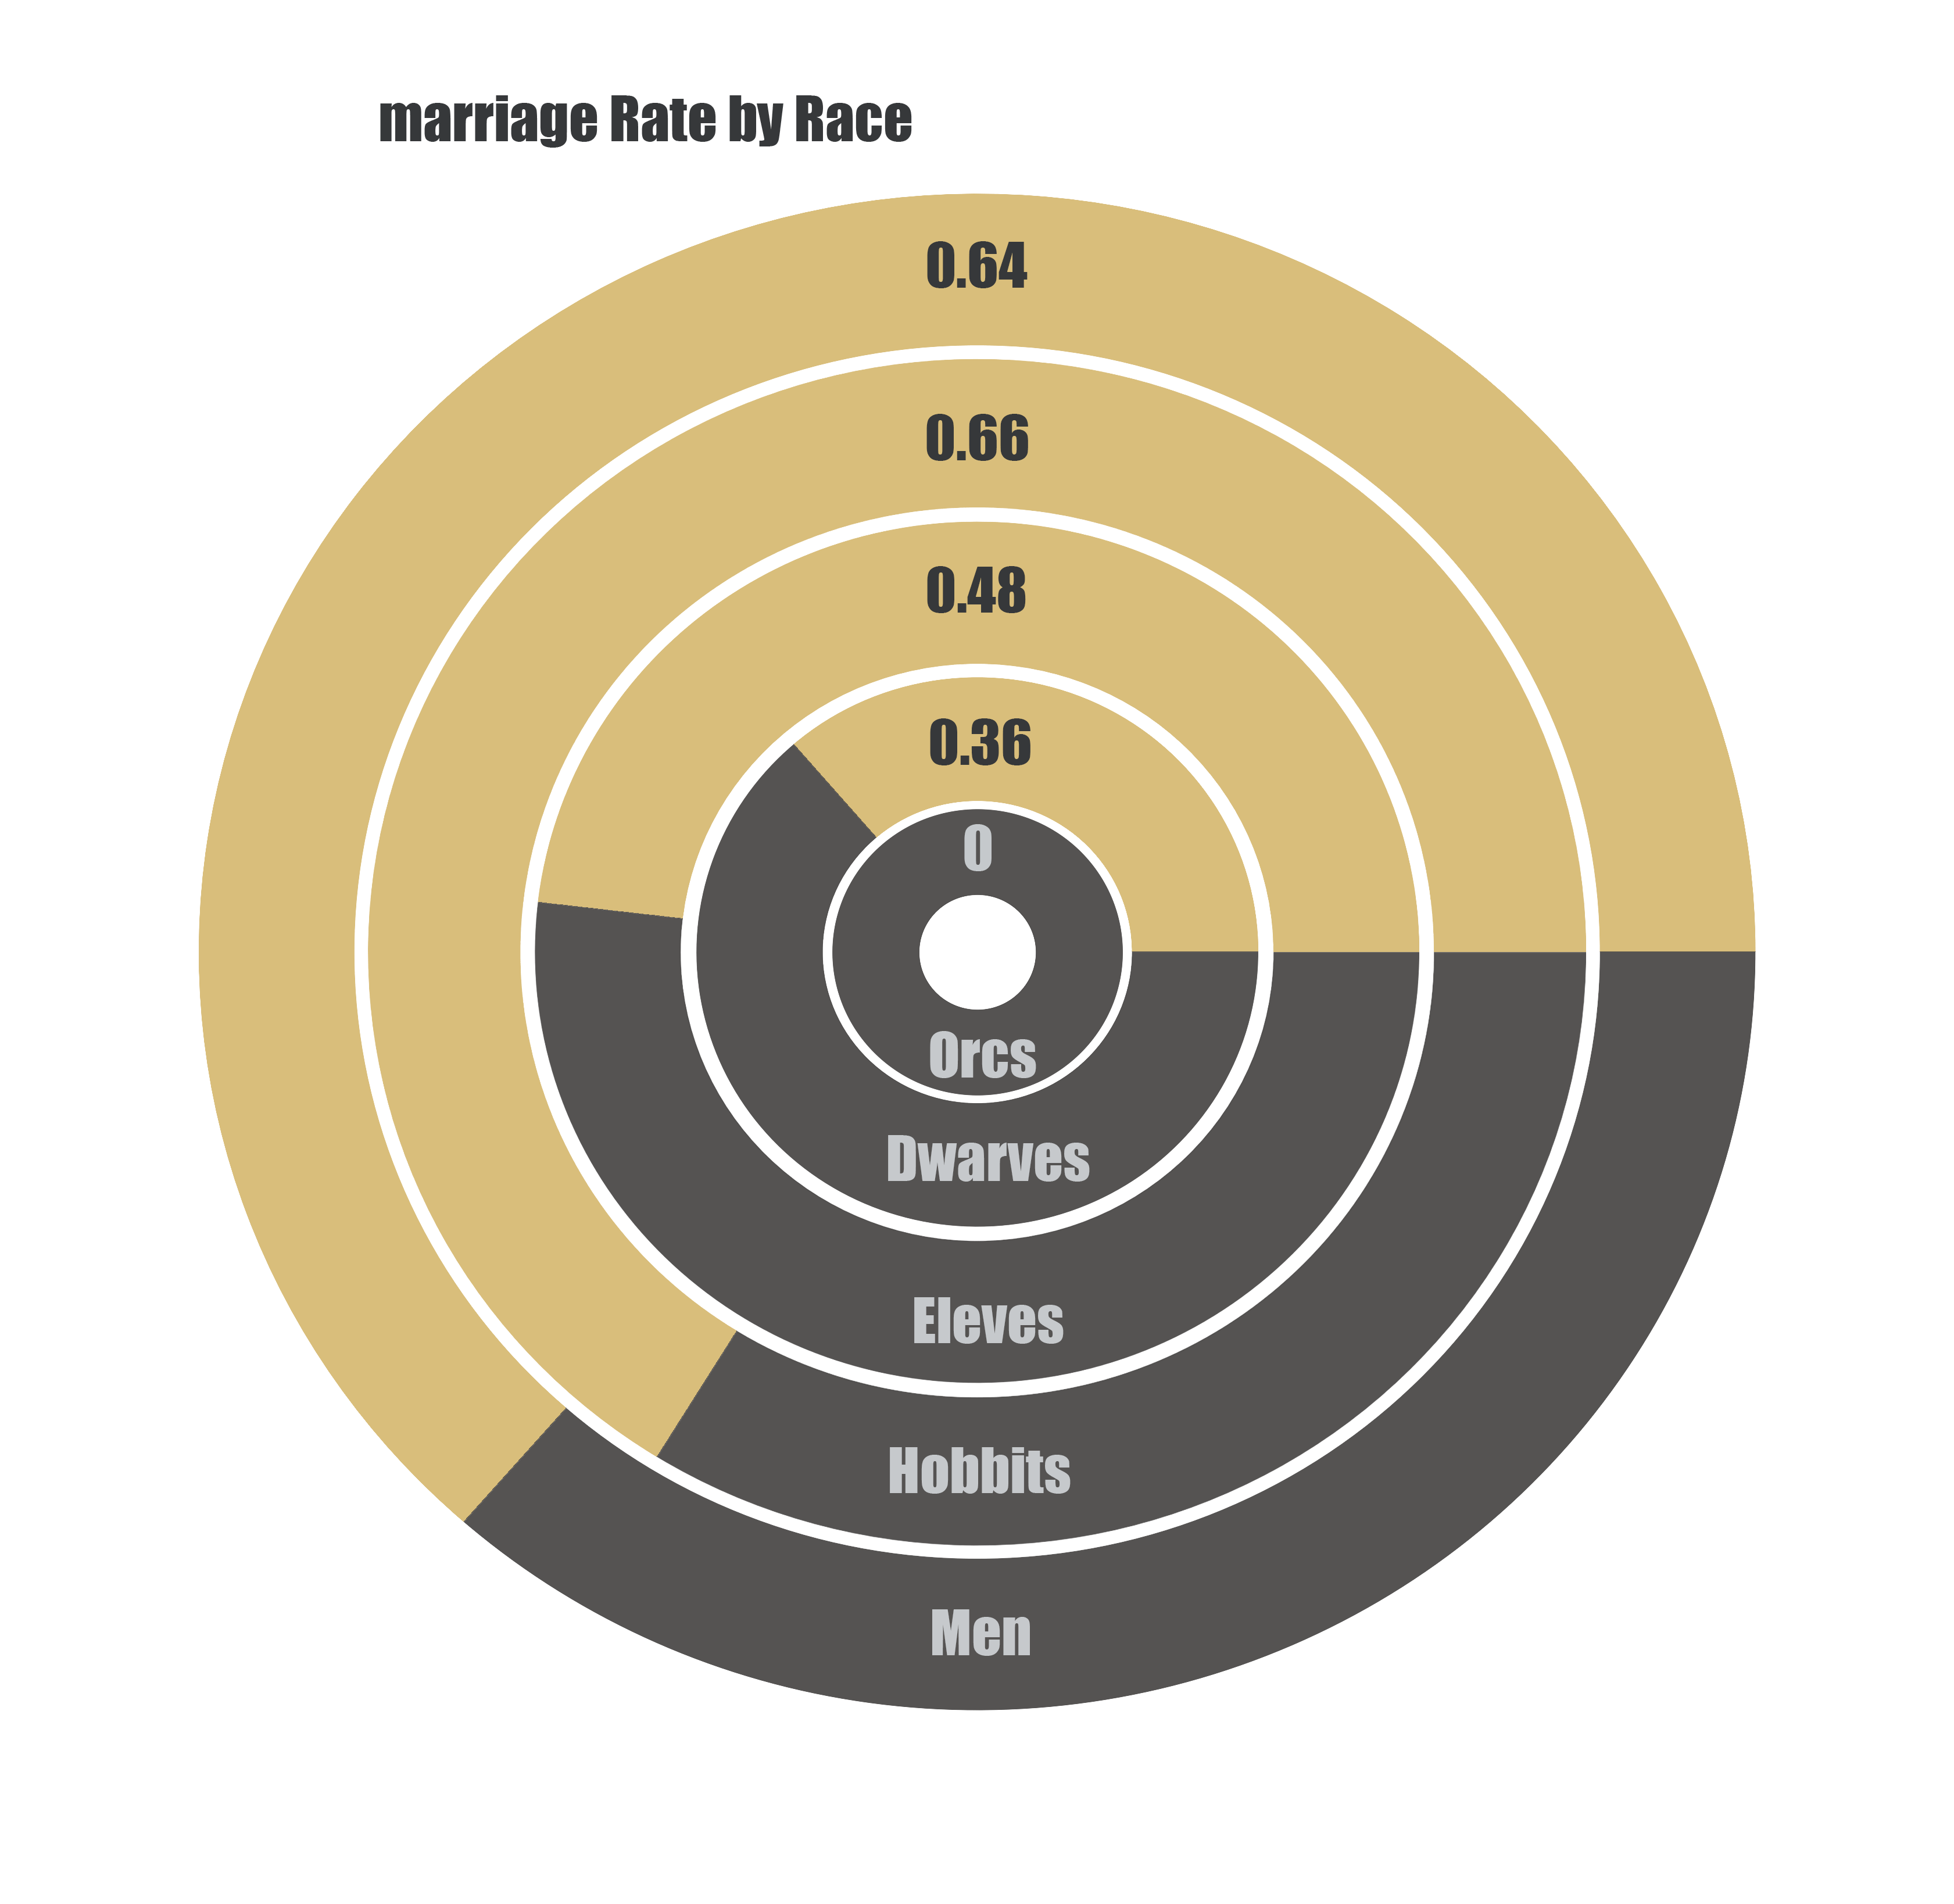

Slide 10
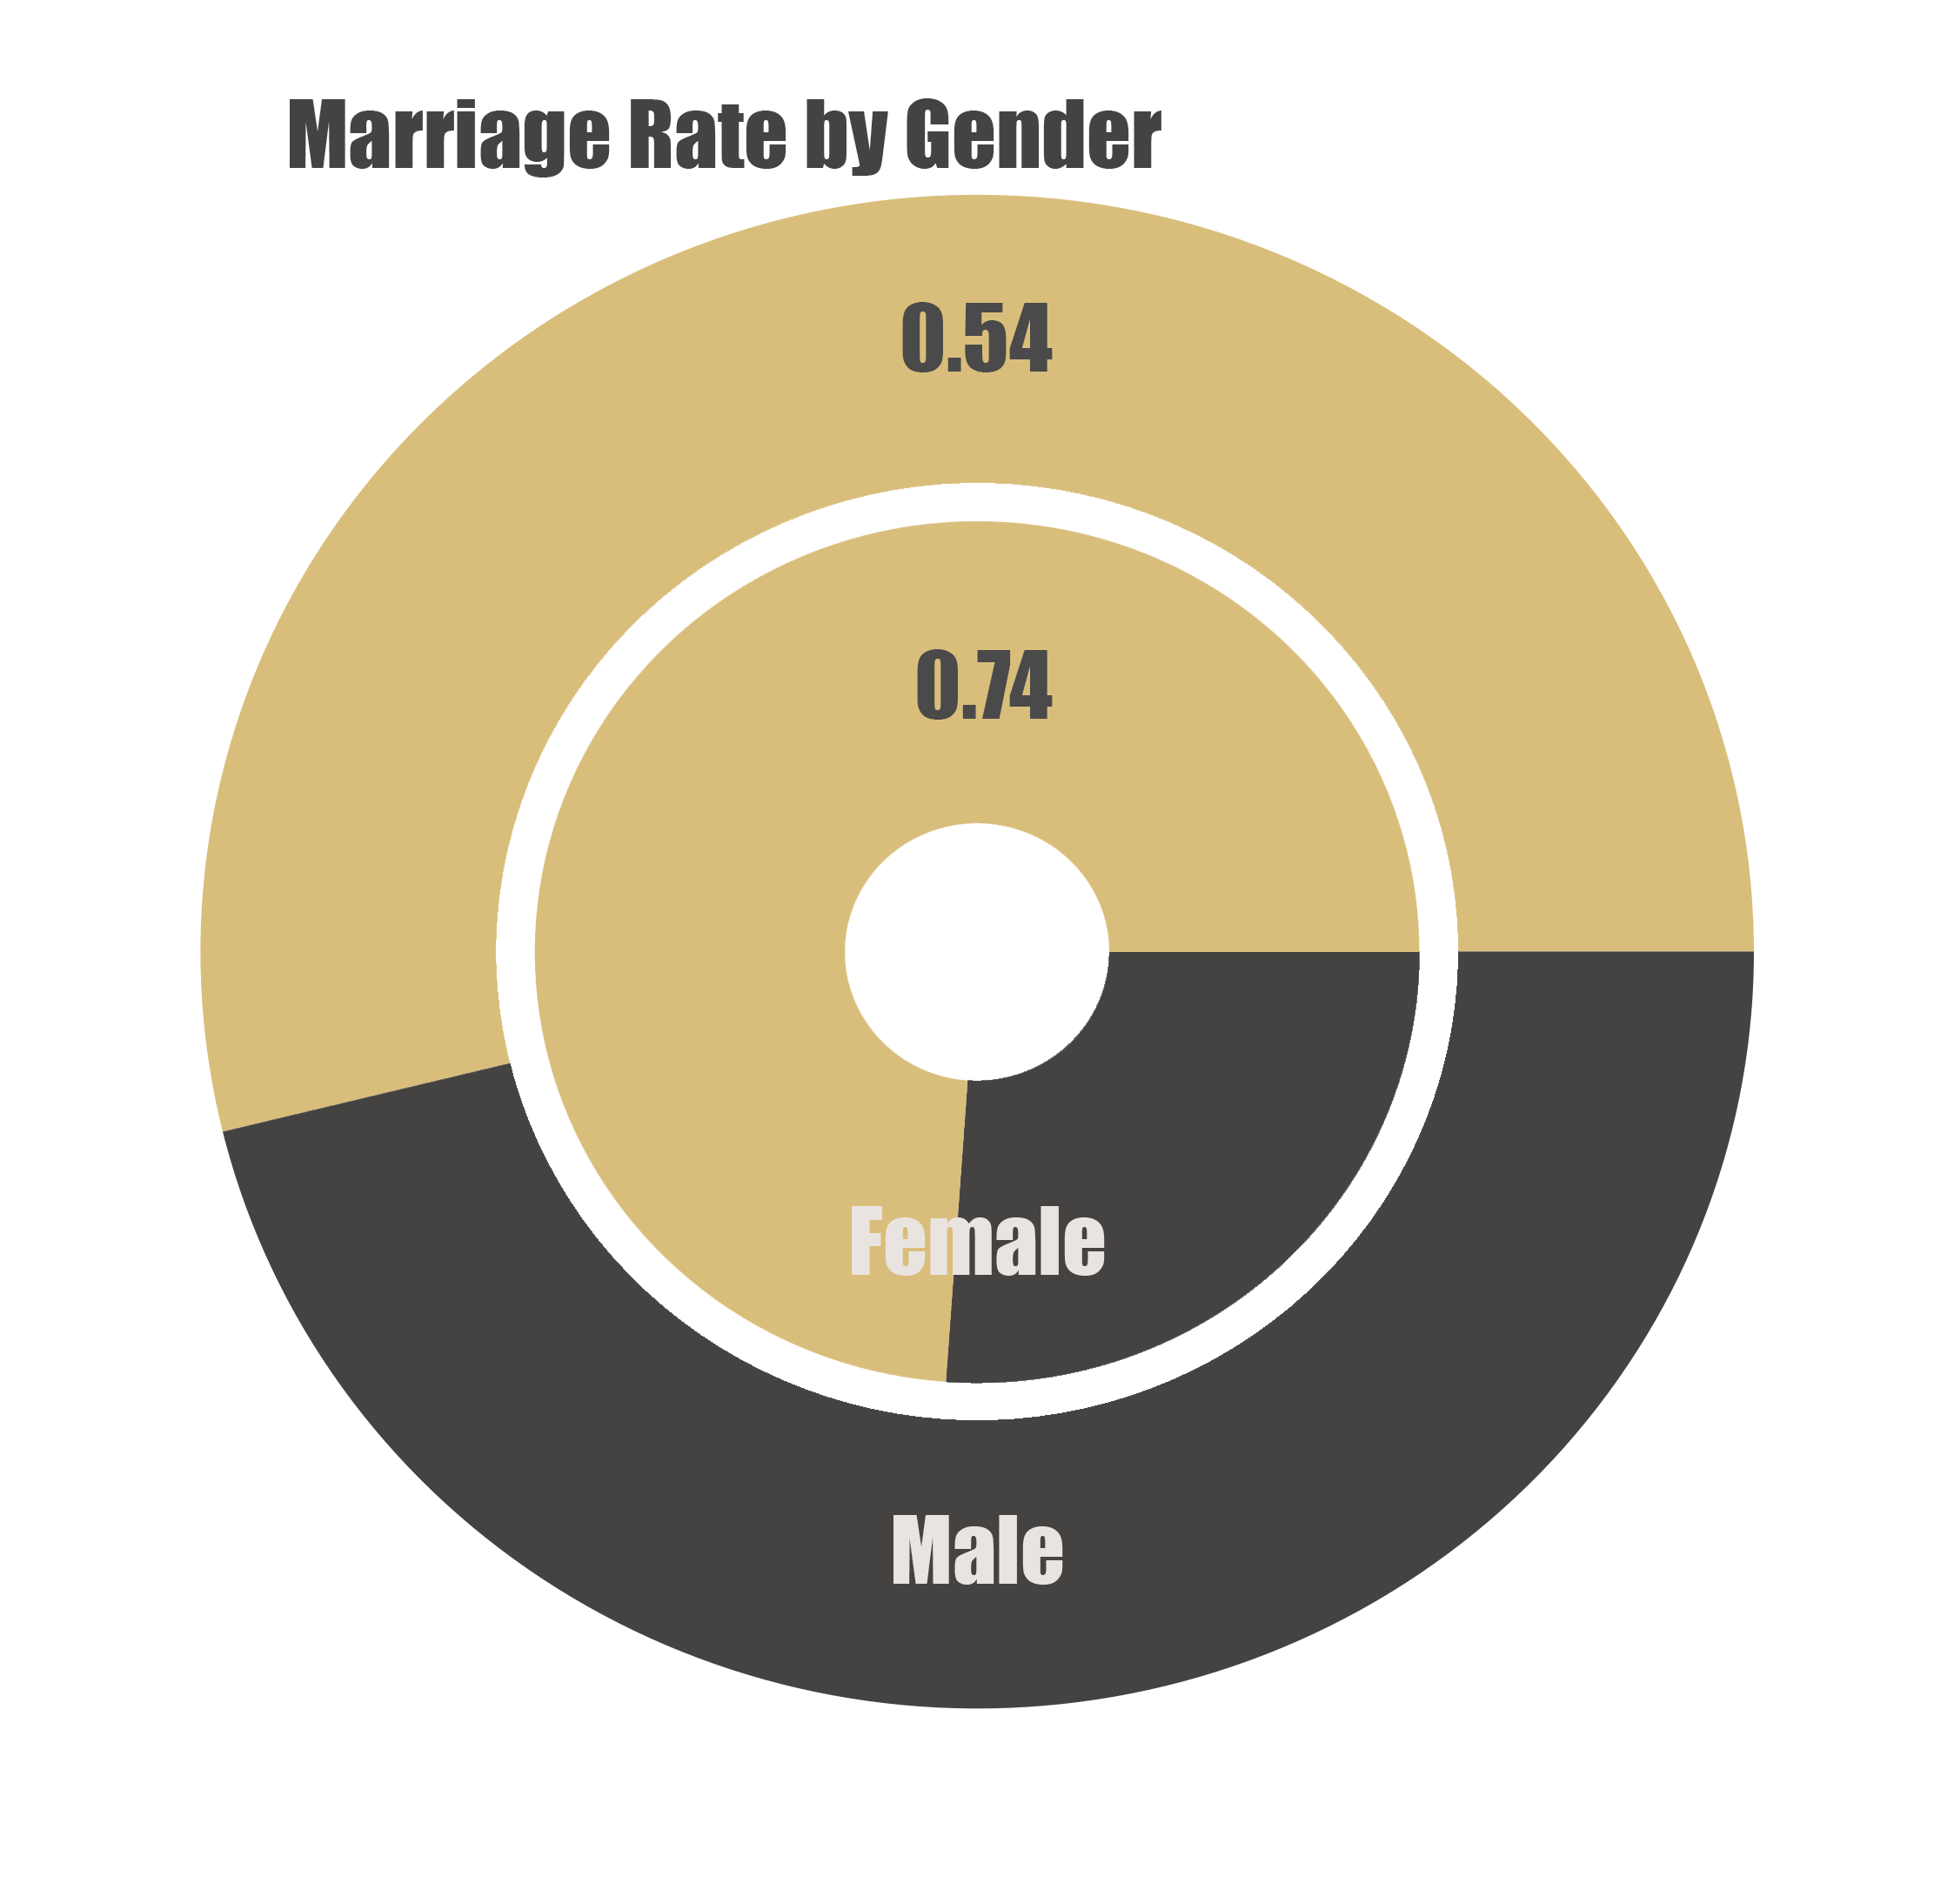

Slide 11
